Slide 1


Advanced Workflow Concepts with System Center 2012 SP1 Orchestrator Andreas Rynes Datacenter Architect Microsoft Corporation
Microsoft Virtual Academy
Notes:
Welcome to this session of Orchestrator, this is called Advanced Workflow Concepts. My name is Andreas Rynes, I’m a datacenter architect within the worldwide datacenter private cloud center of excellence.

Slide 2
Objectives
Describe the components utilized in design and creation of more advanced workflows in Orchestrator
Understand how to create policies incorporating looping, variables and other advanced objects and functions
Notes:
And I would like to discuss with you the components that we are going to use to design and create a little bit more advanced workflows in Orchestrator and we also want to talk a little bit about how to use looping, how to use variables and other advanced objects and functions within runbooks.
Objectives
Start Time 00:01 / Length: 1 minute
Microsoft Lync tools used on this page:
None
Review the learning objectives.

Slide 3
Agenda
Starting Point
Nested Runbooks / Subroutines
Looping (Object Level & Nested Runbooks)
Storing Persistent Data
Complex Link Logic
Making Runbooks Dynamic (Variables)
Data Manipulation
Notes:
So the agenda for today, for this call is talking about starting point, how to start a runbook, what is required there, how to use nested runbooks so having parent/child runbook relations then we would like to talk a little bit about looping, both on object level or activity level or on a runbook level and how to store persistent data and then also how to use complex link logic for doing some branching stuff, and then of course using variables to make runbooks more dynamic and then last but not least we would like to talk a little bit about how to work with data.
IPv6 Subnet and Address Planning
Start Time 00:04 / Length: 3 minutes
Microsoft Lync tools used on this page:
None
Take the students through the subnet and address plan. Explain the various stages of how the plan comes together.

Slide 4



Starting Point
An activity that runs when the runbook is started
Runbook can only have a single starting point
Initialize Data for nested runbooks
Monitors are loaded and waiting for trigger conditions
Monitor WMI, Monitor Process, Monitor Event Log
If condition is met it is creating a runbook instance
Check Schedule can be used to enforce custom defined schedules (e.g. Workdays, …)
Notes:
So starting with the starting point. Whenever you are creating a runbook there needs to be one activity that is going to be the starting point for that runbook and there is only one single starting point allowed with every runbook.
So for example for nested runbooks you have to have an initialized data activity that defines the parameters that needs to be passed into that nested runbook. Other option for a starting point might be monitors so there are a couple of monitors available out of box so for example monitor for a WMI or monitor for a date/time, so that runbook is running every five minutes for example those are options to really use as a starting point for your runbooks. So and whenever those conditions for monitor activities are met they will create a new runbook instance and of course if you are importing integration packs there might be other options there that can be used as a starting point for your runbooks as well. Another thing that might be interesting is using the check schedule activity that can be used to enforce custom defined schedules so for example you’re able to use the monitor date/time activity as a starting point so you’re defining that your runbook will run every five minutes but the second activity will use the check schedule object and that will check if it’s a working day so your runbook will run every five minutes even on the weekends but it will not run further than to the second activity because there it will check against the schedule for example for working days and on the weekends it will stop that runbook instance immediately at that point.

Slide 5

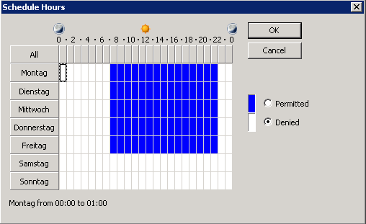
Schedules
Define the times when runbooks can run
Use the system clock of the Runbook server that runs the runbook
Will not be interrupted after processing has started
Assign a schedule to a runbook or use Conditional Links and Check Schedule activity
Days of week
Occurrence
Days of month
Hours
Notes:
So the schedules are really defining the times when the runbooks can run or are allowed to run. The system clock of the runbook will be used for that, so that’s quite important to think of so it’s not your system clock on your machine where you’re using the runbook designer but it’s really using the runbook server system clock for that.
So again, you’re able to assign a schedule to a runbook or use conditional links and check schedule activities so you can check for days of the week for occurrence, for days of month, or for specific hours which you’ll see on that screen shot on the right side.

Slide 6


Nested Runbooks
Workflow execution from runbook to runbook can be nested
Parent runbooks can trigger child runbooks using the Invoke Runbook object
In order for other runbooks to subscribe to data requires configuration:
Use Initialize Data to define input variables
Configure data to be published on the child Runbook Data tab within runbook properties
Use the Return Data object to publish data from child runbook so parent can consume runbook output
Notes:
Nested Runbooks so this is quite an interesting concept within Orchestrator, so when you think about a process within your datacenter you might identify parts of that process you’re going to reuse in a couple of your runbooks so you don’t want to create those runbooks or those processes again and again in all of your runbooks but you want to separate them in a specific runbook that you’re going to use in other runbooks as nested runbooks.
So parent runbooks are able to trigger child runbooks they are using the invoke runbook object which you will see in the middle of the three screen shots, with the invoke runbook you are able to define your runbook that you want to call and then of course you have to push in the parameters and data that needs to be there for the child runbook.
And which parameters needs to be pushed into that child runbook will be defined by the initialize data activity in the child runbooks. So the initialize data on the very left of that screen shot defines the input variables and parameters for that runbook.
And configure data to be published on the child runbook data tab within runbook properties.
So and then last but not least return data so this is an object that you’re going to use in a child runbook to publish data back to the parent runbook and this will be available on the databus in your parent runbook and then you’re able to grab that data in the parent runbook and do some magic with that in your parent runbook in the next activity.

Slide 7

Looping
Looping allows you to build automatic
retries and monitoring within the runbook
Many configurable settings (number of attempts, delay between attempts, etc.)
Available at both Attribute Level and Nested Runbook Level
Right click any runbook activity and select Looping
You can configure looping on a Invoke Runbook activity to enable Runbook Level Looping
Notes:
So looping allows you to loop on both on activity level and runbook level so you’re able to define how often you want to call that same activity in a loop and there are ways to define exit and do not exit conditions so you can define the number of attempts for example, you are also able to define the delay between each attempt so for example you can define that a runbook will be called three times every ten minutes and can be defined again on attribute level and also on the runbook level so if you want to loop over a complete process or part of a process of a runbook you’re able to define that on the invoke runbook activity as well so it will call the runbook and run it completely and do it again and again depending on your configuration.

Slide 8
Storing Persistent Data
Orchestrator has no internal method for storage of state-related data
However activities can be utilized within a runbook to write state data to an external storage location, where it can be retrieved for later use
Useful options for storing persistent data include
SQL Database
Text or Comma-Separated Value File
Notes:
So storing persistent data it’s interesting that Orchestrator has really no internal way to store persistent data so that you’re able to grab that data for a later use. So however there are activities that you can use for that so you can for example use options like writing to a database so there is activities for that so you’re able to store your data within a table within a database.
Another option is using text files for example so you’re able to write to a text file and read from a text file to really storing persistent data that you want to share across runbooks or share also across other tools and environments so those are the options for storing persistent data within Orchestrator.

Slide 9
Smart Link
Links can be configured with Link Conditions that will filter data from the immediately preceding activity in the Runbook.
Link filters can test any data published to the databus
Can be used to build automated decision logic into your runbooks based on any number of criteria
Available Filtering Logic:
Date/Time Comparison
Pattern matching on text-based object output
Numeric Comparisons ( < > = )
Matching based on multiple criteria
Include / Exclude Logic
Notes:
So smart links are a way to define your decision logic within your runbooks so you are connecting your activities within your runbooks using those smart links and on that smart links, on every smart link you’re able to define conditions that will filter data and that will be able to test any data that published to the databus.
And there are a couple of ways to do that filtering logic so there are date/time comparison, there is pattern matching, there is numeric comparison, there is matching based on multiple criteria so you can combine those, you can include and exclude filters and that’s really a powerful way to define your decision logic, so that’s one option so you’re able to do option A or B or C for example within your runbooks but you’re also able to parallyze your activities so if you want to do a couple of different things in parallel you’re able to use that branching and that smart link idea to get the same result there and then you use junction to bring those branches together and go on in your runbook.

Slide 10

Making Runbooks Dynamic (Variables)
Variables allow global declaration of a value accessible to all runbooks
Useful for values that may need to be updated periodically, but are also used in many attributes
Can include static values or select variables
NOW() – For dynamic retrieval of current date/time
%ENVVAR% - System environment variable from target system where policy is running
Runbook server does not enforce variables permissions
Notes:
So to make runbooks more dynamic you’re able to use variables, a concept that I mentioned in our first sessions already, so variables are global declaration of values and those values and those variables are really accessible from all of your runbooks so you define a variable at one place within Orchestrator and you’re able to grab that value and that variable in all your runbooks. That’s useful all the values that you want to update from time to time but you want to do that only in one place and you’re using those variables and those values in multiple runbooks and that’s a good choice to use variables in Orchestrator. So variables in Orchestrator can be used to really include static values but you’re also able to do some specific stuff like adding now for example which give you the current date/time but you’re also able to access the system environment variables from the target system where the runbook is running so using those special values in your variables gives you more options to do more dynamic stuff in your runbooks.
One important thing to note here is that runbook server does not enforce any permissions on that variables so just to make sure that you’re aware of that and below the screen shot just shows you one example of a variable called SCOMServer with some sort of description and a value is just SCOM.global and you’re able in every runbook to access that variable called SCOM Server and you’re able to grab that value out of that variable and use that.

Slide 11

Data Manipulation
Orchestrator contains several functions that allow you to manipulate string or numeric data
For String Data - Trimming spaces, substring search, convert case
For Numeric Data – Basic arithmetic functions (add, subtract, multiply, divide)
Functions can be nested
Outermost function must be enclosed in square brackets [ ] Nested functions do not
Nesting can only be 3 levels deep
Example
[Field(Field('username=judylew@contoso.msft','=',2),'@',1)]
Returns ‘judylew’
Notes:
So what about working with data and data manipulation? There are several function that allows you to manipulate strings or data in Orchestrator and there are different functions for both string data and numeric data for example trimming the spaces or substringing or convert to upper and lower case on your string data and a couple of more we will see that in a second and for numeric data there are really basic functions like add, subtract, multiply, divide, and stuff like that so using that for numeric data is quite interesting and quite useful.
So function can also be nested so you’re able to do nesting on a function level up to three levels deep and the outer most function must be enclosed in square brackets as you see the example below so you have here two different functions and the outer most is enclosed in square brackets.

Slide 12
Data Manipulation (cont)
String Functions
Upper - converts text to upper case
Lower - converts text to lower case
Field - returns text in a specific position relative to a delimiter
Instr - returns the position of first occurrence of text within other text
Right - returns a subset of the text from the right side of the full text
Left - returns a subset of the text from the left side of the full text
Mid - returns a subset of the text from the middle of the full text
LTrim - trims leading spaces from text
RTrim - trims the trailing spaces from text
Trim - trims leading and trailing spaces from text
Len - returns the length of text
Numeric Functions
Sum - returns the sum of a set of numbers
Diff - returns the difference of two numbers
Mult - returns the product of a set of numbers
Div - returns the quotient of two numbers
Notes:
So here are couple of string functions, numeric functions that are available, I don’t want to go into deep of all those functions but you see you can do couple things like upper and lower, you can get substring, you can do right, left, middle, trimming, spaces, you can get the length of a text and for numeric functions there are things like getting the sum of a set of numbers or the difference of two numbers and a couple of others as well but I don’t want to go too deep here probably need to check the documentation for all the functions that are available.

Slide 13
Computer Groups
Set of computers, that can be used to target specific activities to
Add computers dynamically
Using Active Directory queries

Slide 14
Summary
Understanding Nesting and Looping
Object-level Looping
Runbook-level looping
Uses cases for each
Complex Link Logic
Understanding how to use Variables
Review of Data Manipulation Functions
Which common functions are not handled?
How can these be addressed in SCO?
Notes:
So with that we’re almost done so a quick summary for that session, we covered concepts like nesting and looping, looping on an object level as well as a runbook level and a couple of use case for each. We discussed the link logic, how to work with smart links, how to do filtering on published data, how to implement decisions within your runbooks and also how to understand and work with variables and last but not least we discussed the data manipulation functions both for strings and numeric values that’s all part of that session.

Slide 15
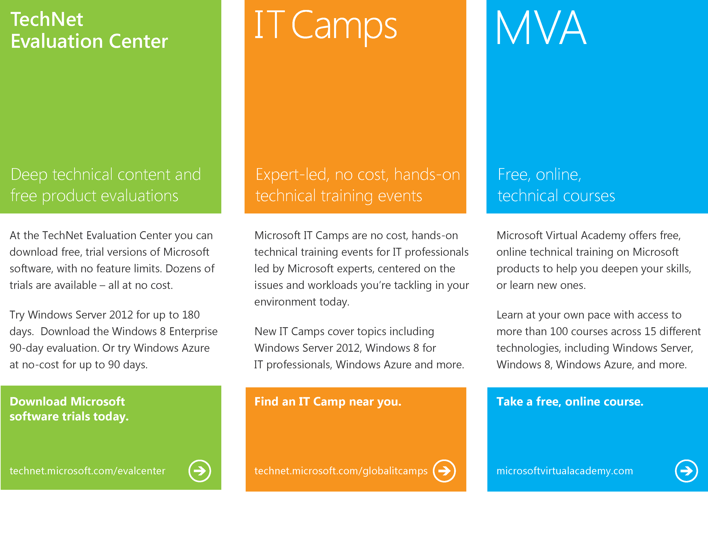
Notes:
And with that I would just like to highlight again the different options you will find out in the net to get more information, first of all go to TechNet Eval Center on technet and microsoft.com/evalcenter there are a lot of software and trial versions available at no cost and then there is there is technet.microsoft.com/globalitcamps which gives you technical trainings also at no cost for IT pros and of course the Microsoft Virtual Academy that offers also online technical trainings on microsoftvirtualacademy.com
So thanks for joining this session and see you soon on the next one around Orchestrator 2012.

Slide 16

© 2012 Microsoft Corporation. All rights reserved. Microsoft, Windows, Windows Vista and other product names are or may be registered trademarks and/or trademarks in the U.S. and/or other countries.
The information herein is for informational purposes only and represents the current view of Microsoft Corporation as of the date of this presentation. Because Microsoft must respond to changing market conditions, it should not be interpreted to be a commitment on the part of Microsoft, and Microsoft cannot guarantee the accuracy of any information provided after the date of this presentation. MICROSOFT MAKES NO WARRANTIES, EXPRESS, IMPLIED OR STATUTORY, AS TO THE INFORMATION IN THIS PRESENTATION.

